Slide 1

Software Requirements Engineering

Slide 2
Interactive system definition
Interactive systems can be defined as the class of systems whose operations involve a significant degree of user interaction.
Common media for interaction include the keyboard, voice recognition, video, touch screen, mouse etc.
The process of formulating the software requirements for such systems must take into account the important issues associated with such systems.

Slide 3
Issues to be taken into account for interactive systems
User interface. The ability to model and represent user interface requirements
User classes. Interactive systems often have varied classes of users with varying (potentially conflicting) requirements and expectations.
Other systems. Interactive systems may interface with other systems in their environment.

Slide 4
Requirement issues for interactive systems
Indirect system concerns. These are issues related to system design and implementation, the influence of the system on the organisation and the system’s influence on the environment.
Quality of service. The closeness of the system to the end-user lends special significance to quality of the service delivered. Quality concerns include:
  Availability
  Performance
  Usability
  Form of delivery

Slide 5
Using VORD to specify an interactive system
The automated teller machine (ATM) is a good example of an interactive system as it embodies all the attributes discussed earlier.
In the next discussion we will use the VORD method, to formulate the requirements of the ATM.
VORD has been primarily developed to support the specification of interactive systems and focuses on the external entities that interact with the system or affect its development.

Slide 6
ATM requirements
A simplified ATM contains an embedded software system to drive the machine hardware and to communicate with the bank’s customer database.
1. The system accepts customer requests and produces cash and account information, and provides for limited message passing and funds transfer.
2. The ATM is also required to make provisions for major classes of customers, namely customers whose account is with the bank which owns the ATM (home customers) and customers from other banks who have ATM access (foreign customers).

Slide 7
ATM requirements (contd..)
3. ATM users are issued with a cash-card and a personal identification number (PIN) that they must use to access the ATM services.
4. Home customers receive all the services provided by the ATM. Foreign customers can only receive a subset of ATM services (i.e. they can only access the ATM to withdraw cash).
5. The ATM is also required to update the customer account database each time there is a cash withdrawal or funds transfer.
6. All the services provided by the ATM are subject to certain conditions, which can be considered at different levels.

Slide 8
ATM requirements (contd.)
6.1 The top level sets out conditions necessary for accessing the services. These include a valid ATM cash-card and correct personal identification number (PIN).
6.2 The next level is concerned with service requests and is subject to the availability of particular services.
6.3 At lowest level, all services provided by the ATM are subject to specific conditions set out for their provision. For example, customers can only withdraw cash to a maximum of their balance.

Slide 9
VORD
The requirements model adopted by VORD is service-oriented where viewpoints are analogous to clients in a client-server system.
The system delivers services to viewpoints and the viewpoints pass control information and associated parameters to the system.
Viewpoints map to classes of end-users of a system or to other systems interfaced to it.

Slide 10
VORD (contd.)
A VORD viewpoint is an entity outside the system that generates a requirement (i.e. a requirement source).
A viewpoint can be a system user, a sub-system interfaced to the intended system or an organizational concern.
Viewpoints are structured into a classification hierarchy to accommodate the variations in user requirements.

Slide 11
VORD (contd.)
VORD viewpoints fall into two classes:
  1. Direct viewpoints correspond directly to clients in that they receive services from the system and send control information and data to the system.
    • Direct viewpoints are either system operators/users or other sub-systems, which are interfaced to the system being analysed.
  2. Indirect viewpoints have an ‘interest’ in some or all the services which are delivered by the system but do not interact directly with it.
    • Indirect viewpoints may generate requirements, which constrain the services delivered to direct viewpoints, and the system development process.
    • Indirect viewpoints vary radically. They may include engineering viewpoints, organizational viewpoints and external viewpoints.

Slide 12
VORD (contd.)
The VORD method is based on three main iterative steps, namely:
1. Viewpoint identification and structuring
2. Viewpoint documentation
3. Viewpoint requirements analysis, specification and
validation

Slide 13
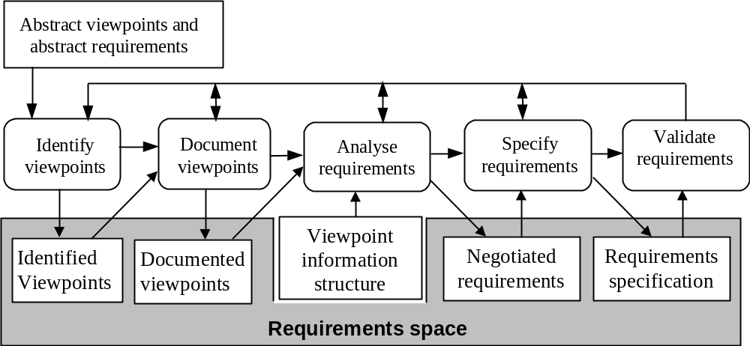
VORD process model

Slide 14
Viewpoint template
VORD uses standard templates to record viewpoint and requirement information. A viewpoint template comprises:
  A viewpoint identifier number
  A viewpoint name or label
  Description of the role of the viewpoint in the problem domain
  A viewpoint type (Traces the viewpoint to its parent class)
  Attributes that characterize the viewpoint in the problem domain. Attributes represent the control information supplied by the viewpoint to the system.
  Event scenarios that describe the interaction between the viewpoint and the system.
  Viewpoint specializations or subclasses.
  Viewpoint history that describes the evolution of viewpoint requirements

Slide 15
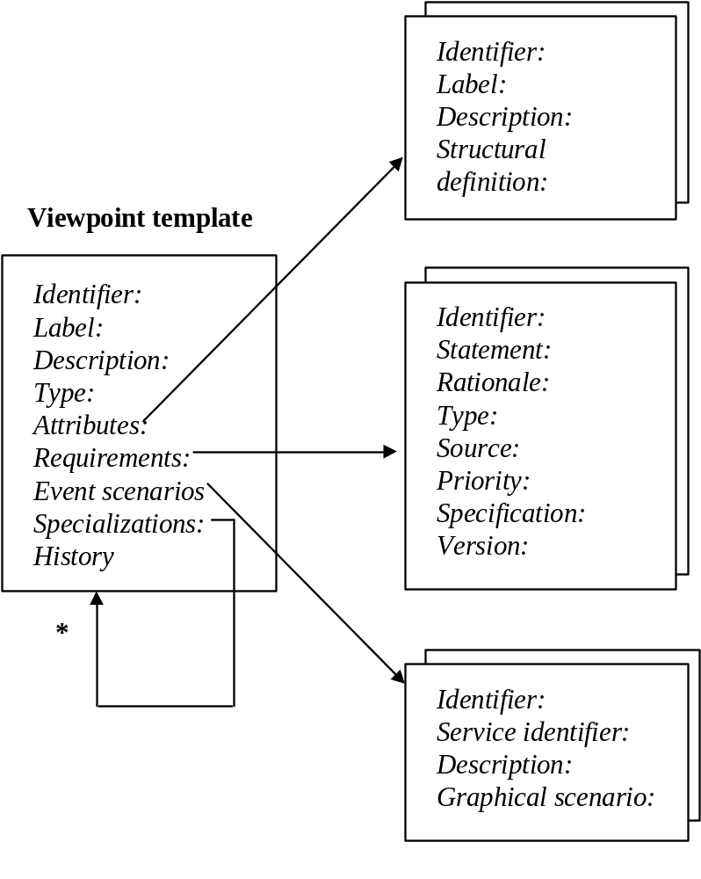
Viewpoint template

Slide 16
Viewpoint notation
VORD uses a simple graphical notation to represent a viewpoint:
  A rectangular box represents the viewpoint.
  The viewpoint identifier is shown on the top left-hand corner of the box and the viewpoint label in the lower half of the box.
  The viewpoint type is shown on the top right half of the box.
  A viewpoint attribute is indicated by a vertical line dropping from the left side of the box.
  Viewpoint specializations or sub-classes are shown from left to right.
The notation is augmented with viewpoint information templates

Slide 17
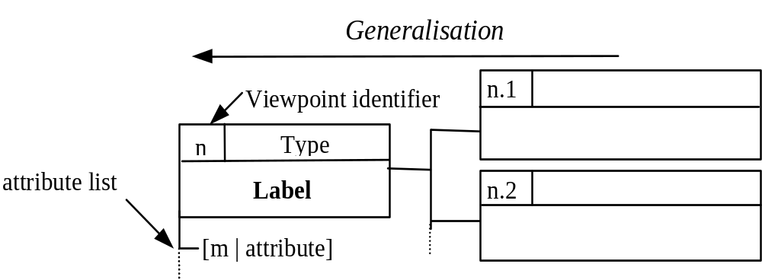
Viewpoint notation

Slide 18
Identifying ATM Viewpoints
The process of understanding the system under analysis, places a lot of reliance on the ‘system authorities’
  These are people or documents with an interest or specialist knowledge of the application domain.
  They include system end-users, system procurers, system engineers and documentation of existing system(s).
VORD has generalised these ‘system authorities’ into a set of abstract viewpoint classes, which can be used as a starting point for finding viewpoints specific to the problem domain.

Slide 19
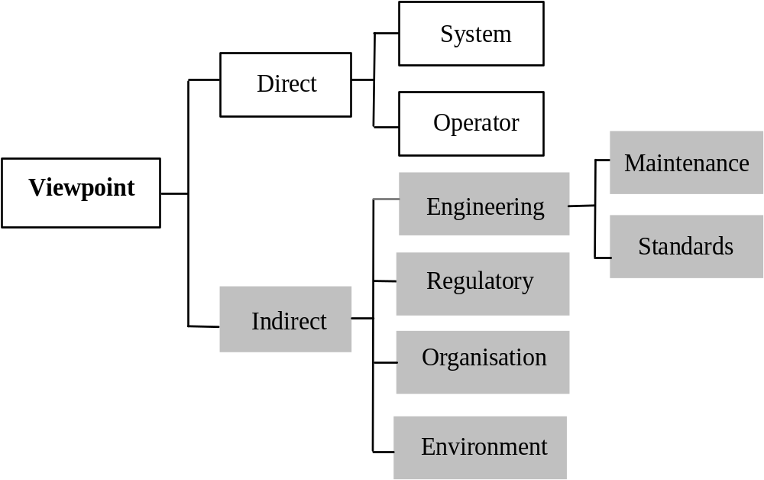
Abstract viewpoint classes

Slide 20
Using abstract viewpoints to identify application specific viewpoints
1. Prune the abstract viewpoint class hierarchy shown in , to eliminate viewpoint classes which are not relevant for the specific system being specified. In the ATM example, let us assume that there is no external certification authority and no environmental effects. We therefore do not need to look for viewpoints under these headings.
2. Consider the system stakeholders i.e. those people who will be affected by the introduction of the system. If these stakeholders fall into classes which are not part the organisational class hierarchy, add these classes to it.
3. Using a model of the system architecture, identify system viewpoints, i.e. viewpoints representing other systems. In the example of the ATM we can identify two main sub-system, the customer database and card database. We note that architectural models of systems almost always exist because new systems must be integrated with existing organisational systems.

Slide 21
Using abstract viewpoints to identify application specific viewpoints
4. Identify system operators who use the system on a regular basis, who use the system on an occasional basis and who request others to use the system for them. All of these are potential viewpoints. We can identify four instances of direct viewpoint in this example namely the bank customer (regular), ATM operator (occasional), the bank manager (occasional).
5. For each indirect viewpoint class which has been identified, consider the roles of the principal individual who might be associated with that class. For example, under the viewpoint class ‘customer’, we might be interested in the roles of ‘regulations officer’, ‘maintenance manager’, ‘operations manager’ etc. There are often viewpoints associated with these roles. In the ATM example, there are many possible indirect viewpoints but we will confine our analysis to a security officer and a organisational policy, represented by the bank viewpoint.

Slide 22
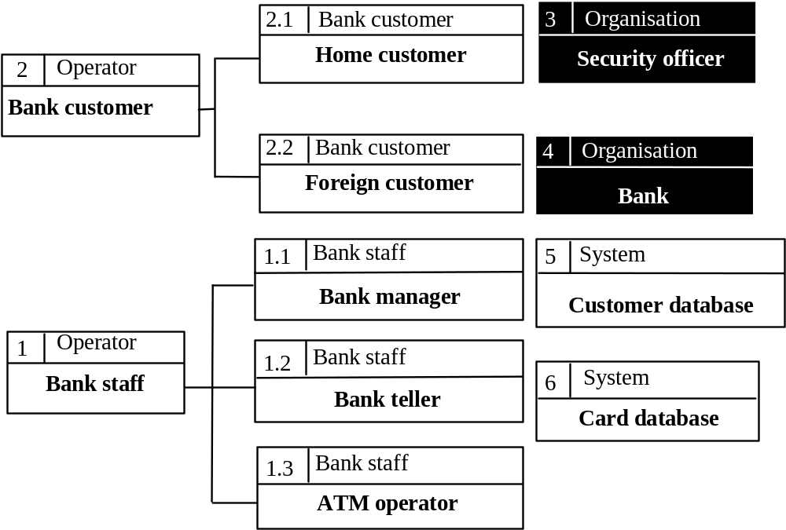
ATM viewpoints

Slide 23
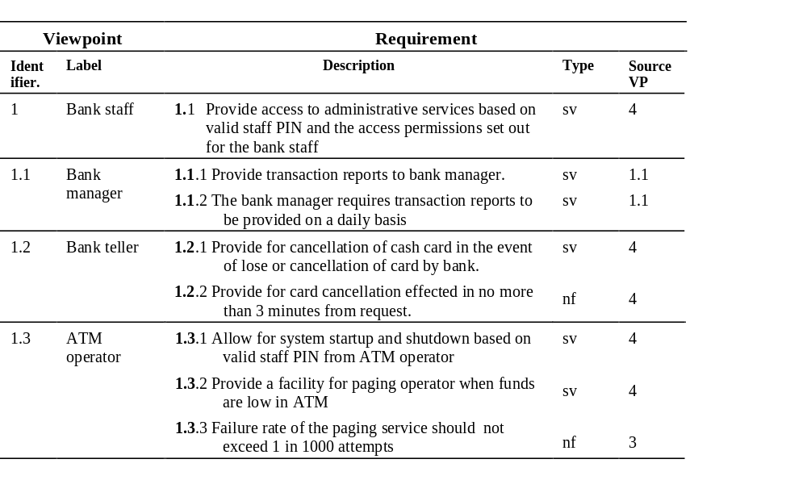
Bank staff viewpoint documentation

Slide 24
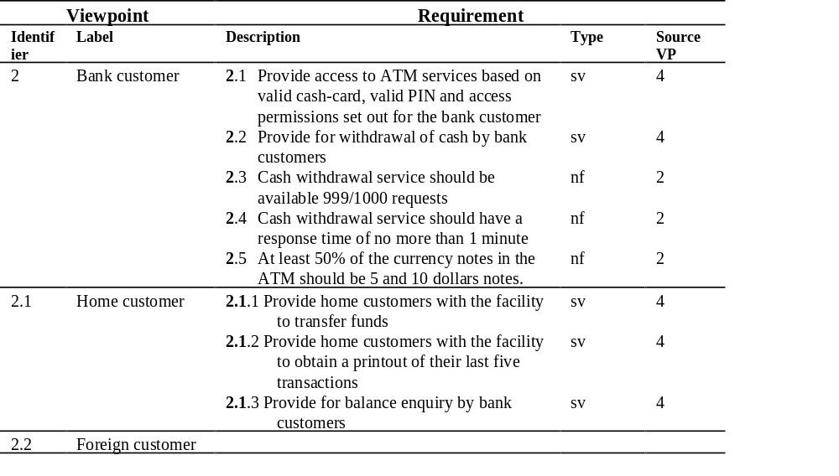
Bank customer viewpoint documentation

Slide 25
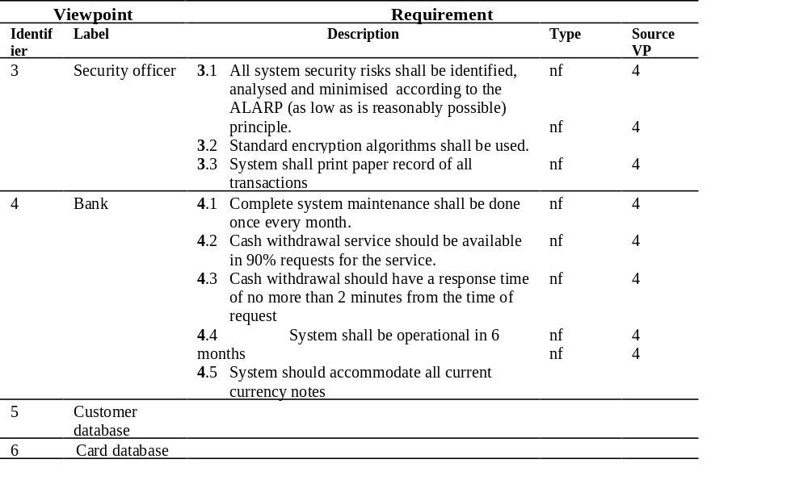
Documenting other viewpoints

Slide 26
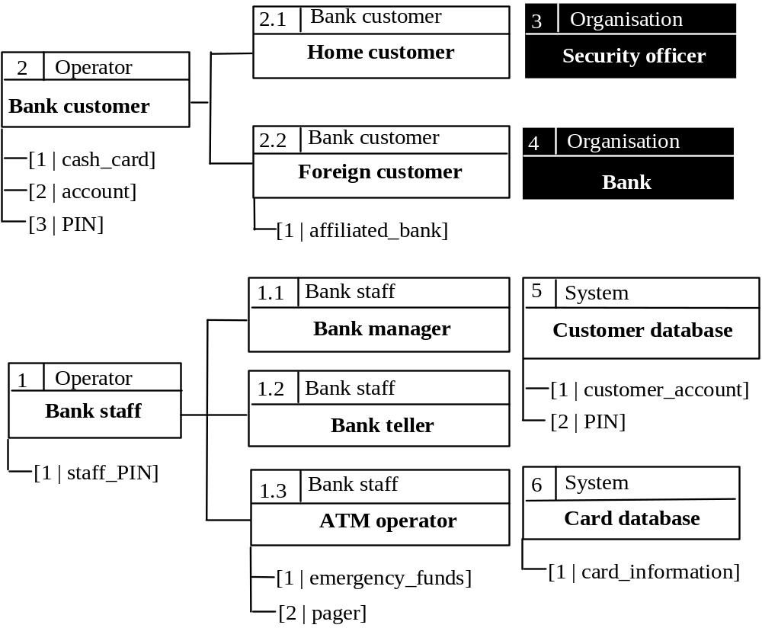
Documenting viewpoint attributes

Slide 27
Prioritizing requirements
The most obvious way to prioritise requirements, is to base priorities on the relative importance of the requirements with respect to the viewpoint
This fails to take into account the resources needed to deliver the requirement and the risk associated with the requirement
VORD includes a simple weighting scheme that organises weightings around importance, resources and risk
Each requirement is weighted as high(H), medium (M) or low(L) in relation to each of the three factors on a scale of 1-3

Slide 28
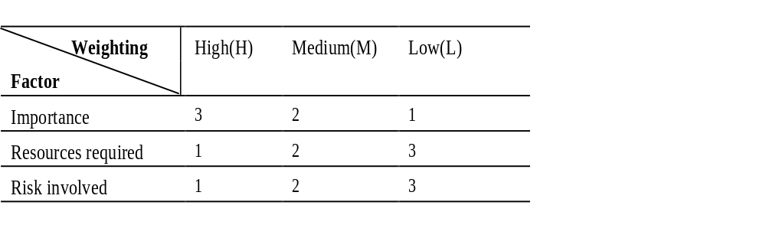
Incorporating risk and resources
The factors shown below may vary across applications and organizations

Slide 29
Non-functional requirements
Non-functional requirements translate to constraints on viewpoint services, attributes and the development process in general
The next table shows how the constraints affect various viewpoint services.
  The table also provides an indication of the coverage of the constraints, for example, global constraints are associated with all customer and other services
  Specific constraints are shown with respect to each affected service. The coverage of the constraints provides an important input to the analysis process.

Slide 30
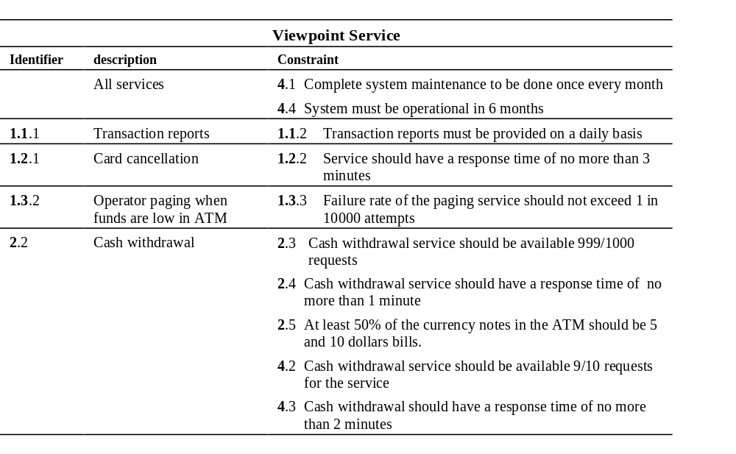
Constraints on services

Slide 31
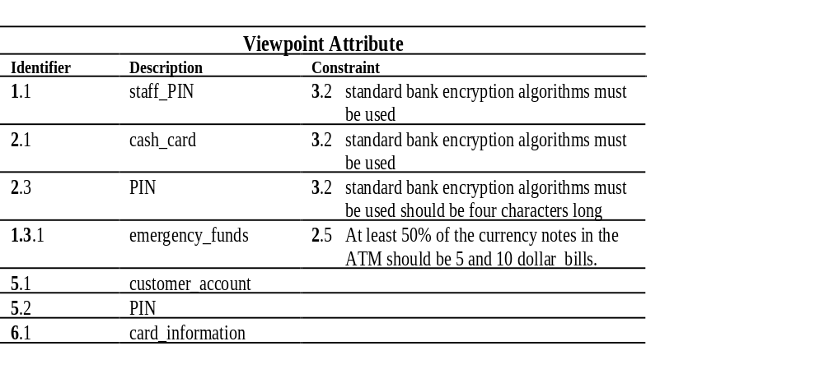
Constraints on attributes

Slide 32
Modeling system behaviour
VORD uses event scenarios to model dynamic system behaviour.
An event scenario is defined as a sequence of events together with exceptions which may arise during the interchange of information between a viewpoint and the intended system.
Viewpoint events are a reflection of control requirements as perceived by the user.
VORD uses an extended state transition notation to model event scenarios.

Slide 33
Event scenario rules
A normal sequence of events may have exceptions at various points in the event sequence.
At the system level, exceptions cause a transfer of control to exception handlers.
Exceptions are shown in grey arrows and normal sequences in black.
A transition is triggered by an event and/or preconditions, which must be satisfied before the transition, can take place.
An event may include an optional set of parameters, and may be accompanied by a set of actions.

Slide 34
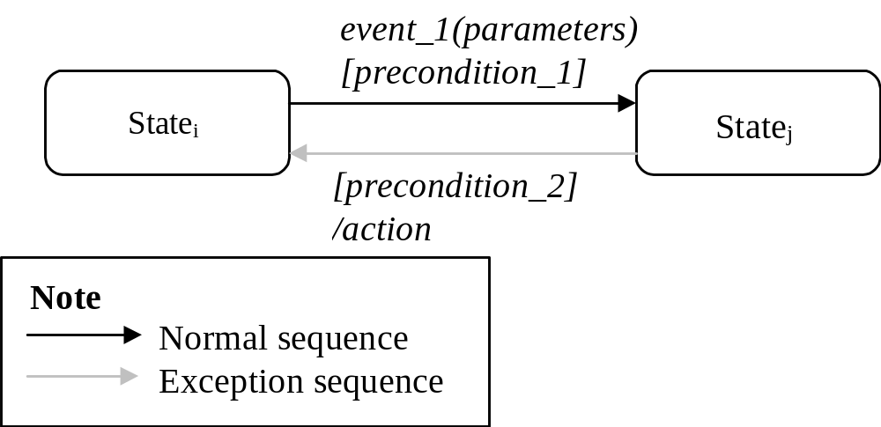
Scenario notation

Slide 35
Event scenario for accessing ATM services
Before a customer can access an ATM service, the system needs to be in the service ready state shown by the grey rectangle
When the system is in the ready state, it sets out the preconditions necessary for accessing the ATM services, namely:
  A valid cash card and,
  A correct PIN
These conditions must be satisfied before the system can go into the service state.
  In the service state the system displays the available services.

Slide 36
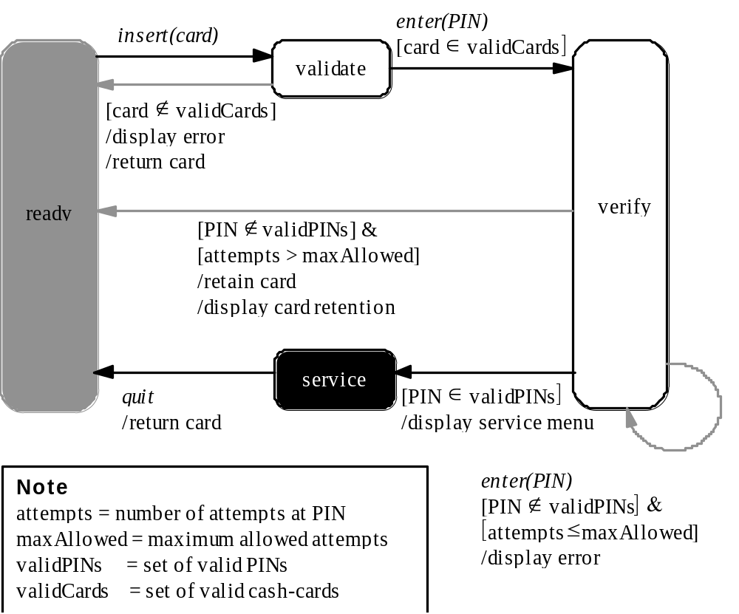
Event scenario for accessing ATM services

Slide 37
Formulating user interface requirements
User interface considerations are important in formulating the requirements of interactive systems
They are highly subjective and difficult to establish through a structured process of requirements analysis
In many cases, user interface requirements can only be determined through experiment and prototyping
However there is a close relationship between user interface requirements and viewpoints

Slide 38
User interface requirements and viewpoints
User interface requirements describe the mode and presentation of viewpoint services.
They can therefore be represented as constraints on viewpoint services
This process is, in turn, informed by viewpoint event scenarios which describe the interaction between the viewpoint (in this case the user) and the system

Slide 39
User interface requirements and viewpoints (contd.)
A service is provided through the interaction between a viewpoint and the system.
The interaction is described using event scenarios
The viewpoint requiring the service may impose certain constraints on the way the service is presented
These may include constraints on mode of the presentation and how the presentation is organised (layout).

Slide 40
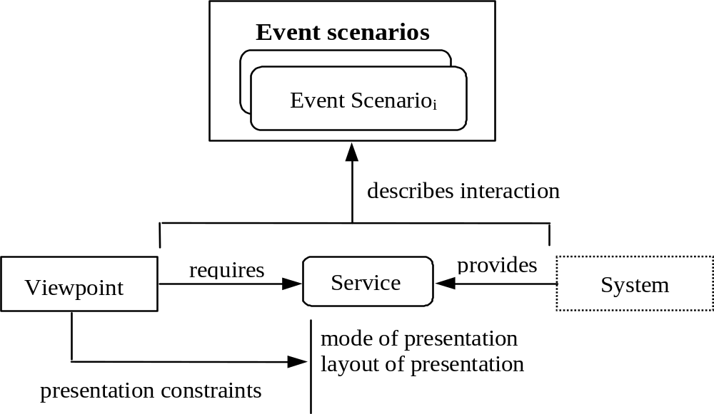
User interface requirements and viewpoints (contd.)

Slide 41
Requirements analysis
The objective of viewpoint requirements analysis is establish that viewpoint requirements are correct and ‘complete’.
There are two main stages to this analysis.
  1. Correctness of viewpoint documentation. The viewpoint documentation must be checked to ensure that it is consistent and that there are no omitted sections.
  2. Conflict analysis; conflicting requirements from different viewpoints must be exposed and resolved.

Slide 42
Checking viewpoint documentation
This involves verifying that a viewpoint has been correctly and completely documented.
We have defined viewpoint as a entity consisting of a number of components (attributes, requirements etc).
Although some of this information must appear on all viewpoints, other information may be omitted depending on whether the viewpoint is direct or indirect.

Slide 43
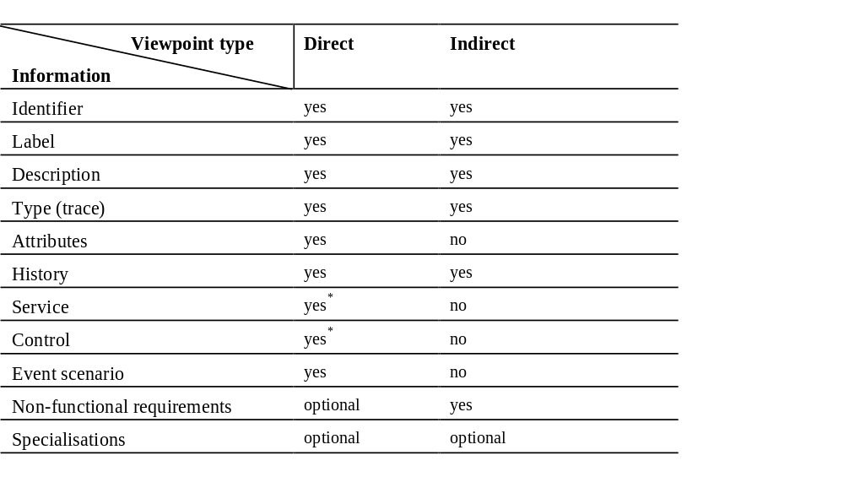
Viewpoint type and the need for corresponding documentation

Slide 44
Viewpoint type and the need for corresponding documentation (contd)
1. A ‘yes’ means that the documentation must be present in the viewpoint, for example, a viewpoint must be uniquely labelled and traceable to abstract viewpoints.
2. A ‘no’ means that the corresponding documentation is not part of the viewpoint , for example an indirect viewpoint does not receive services or provide control information.
3. An ‘optional’ means that the documentation may optionally be present in the viewpoint. For example viewpoints may or may not have specializations; and direct viewpoints may or may not have non-functional requirements. Where an optional documentation is present, it must be checked against other related documentation .
4. ‘yes*’ denotes a set of information, at least one of which must be documented in the viewpoint.

Slide 45
Conflict analysis
Viewpoints have differing stakes in and interactions with the intended system and have requirements that are closely aligned with these interests
Conflicts may arise from contradictions among individual viewpoint requirements
Examples include:
  where the service provision across viewpoints is associated with different constraints of the same general type
  where the provision of a service across viewpoints is associated with similar constraints; but differing constraint values

Slide 46
Conflict analysis (contd.)
These type of conflicts can be exposed by:
  1. Analysing the constraints associated with a particular service, for consistency
  2. Analysing one viewpoint’s requirements against other viewpoint (all) requirements for contradictions.
In addition to these specific viewpoint requirements, all individual requirements must be analysed against high-level organisational and other global requirements that define the general quality attributes of the intended system (e.g. safety, security..).

Slide 47
Conflict resolution and management
Requirements conflict resolution and management is the subject of on-going research
There is no simple way of automating all the aspects of conflict resolution.
The checking model adopted by VORD is based on ensuring that information can be presented in a way that manual analysis is simplified.
Individual requirements are checked against each other, and against the global requirements.

Slide 48
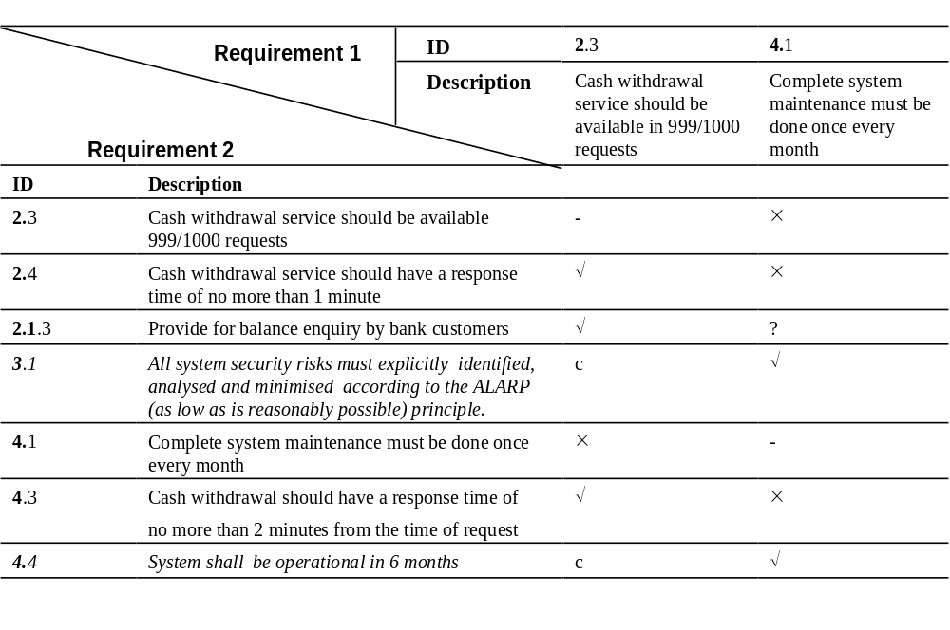
Example of ATM system conflict identification

Slide 49
Service specification
VORD supports the specification of viewpoint services in a variety of notations. This is particularly important for two reasons:
  1. The ability to represent the same requirement in different notations which are familiar to different people enhances communication and aids understanding.
  2. No one requirements notation can adequately articulate all the needs of a system. More than one specification language may be needed to represent the requirement adequately.
If more than one notations is used to specify the same requirement, then it is important to ensure that the two specifications are consistent

Slide 50
Informal specification of the ATM cash withdraw service
Customer requests cash withdrawal
if any of the following conditions is true refuse withdrawal:
condition1: The requested amount exceeds customer balance.
condition2: The funds in ATM are less than requested amount
else do the following:
dispense cash
update customer account
endif

Slide 51
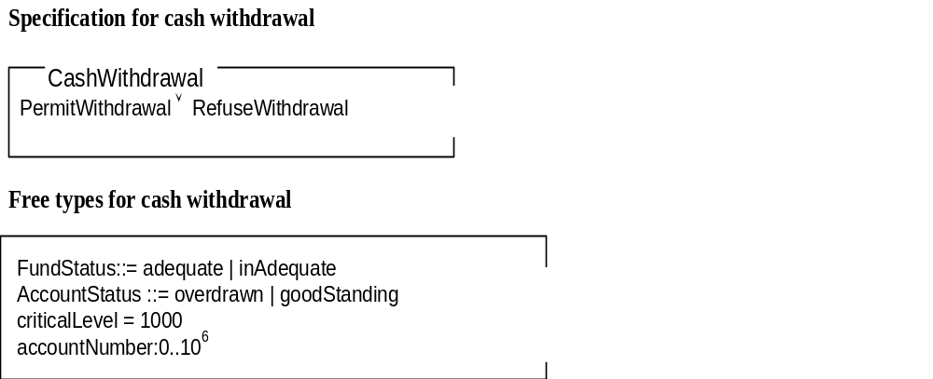
Formal specification using Z

Slide 52
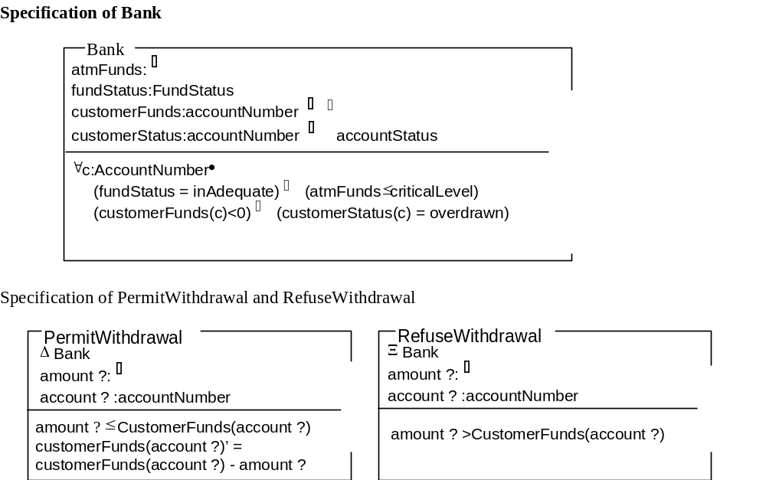
Formal specification using Z

Slide 53
Requirement specification document
The final product of the requirements definition process is a requirements document.
The IEEE standard 830-1993 recommends that the requirements document should have 3 main sections.
Section 1 introduces the purpose and scope of the requirements document.
Section 2 describes the factors that affect the intended system and its requirements.
Section 3 describes the software requirements.

Slide 54
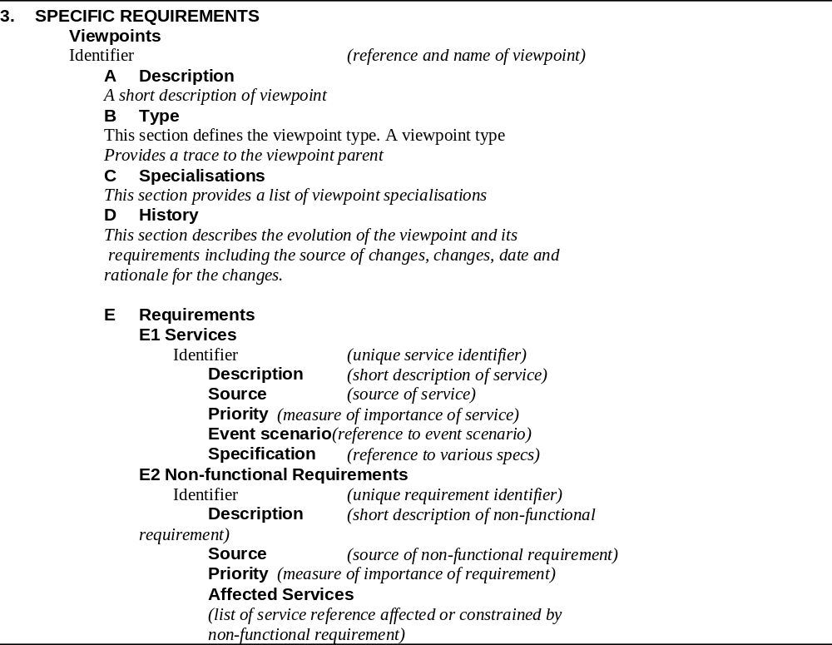
Structure of VORD requirements document (section 3)

Slide 55
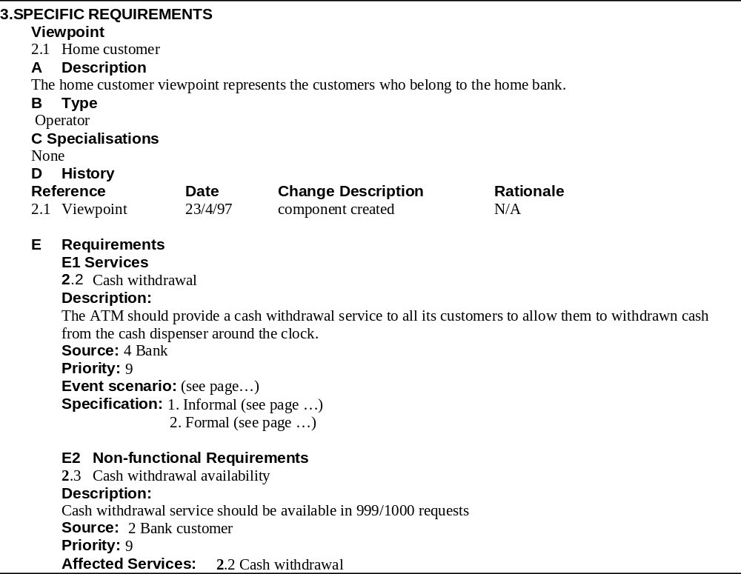
Part of ATM requirements document

Slide 56
Keypoints
Interactive systems can be defined as systems whose operations involve a significant degree of user interaction
To be effective, the requirements definition process must address usability, varied user requirements, environment, organisational, quality of service issues posed by these systems.
A natural way to specify interactive systems is to specify the services which they provide for end-uses and other systems

Slide 57
Keypoints
VORD is based on viewpoints that focus on user issues and organisational concerns.
VORD defines two main types of viewpoints; direct and indirect.
System behaviour is defined in VORD using event scenarios.
Scenarios can used to describe exceptions and normal behaviour.

